Slide 1

Department of Computer Science
University Institute of Engineering
DEPARTMENT OF COMPUTER SCIENCE & ENGINEERING
Bachelor of Engineering
Subject Name: System Programming
Subject Code: CST-315
Compilers
DISCOVER . LEARN . EMPOWER

Slide 2
Chapter-1.2 Assembler
Department of computer Science
Variants of Assemblers
Design of two pass assembler

Slide 3
Variants of Assemblers
There is a list of assemblers ,computer programs that translate assembly language source code into binary programs. Some assemblers are components of a compiler system for a high level language and may have limited or no usable functionality outside of the compiler system.
- Some assemblers are hosted on the target processor and operating system, while other assemblers (cross-assemblers) may run under an unrelated operating system or processor.

Slide 4
Variants of Assemblers
As part of a compiler suite
GNU Assembler (gas): GPL: many target instruction sets including ARM architecture, Atmel AVR, x86, x86-64, Freescale 68HC11, Freescale v4e, Motorola 680x0, MIPS, PowerPC, IBM System z, TI MSP430.
ASxxxx Cross Assembler (part of the Small Device C Compiler project): GPL: several target instruction sets including Intel 8051, Freescale 68HC08, PIC microcontroller.
The Amsterdam Compiler Kit (ACK) targets many architectures of the 1980s, including 6502, 6800, 680x0, ARM, x86 and Z8000.
LLVM targets many platforms, however emits no per-target assembly language, instead more high-level typed intermediate representation assembly-like language used.
Some others self-hosted native-targeted language implementations (like Go, Free Pascal, SBCL) have their own assemblers with multiple targets. They may be used for inline assembly inside language, or even included as a library, but not always suitable for standalone application - no command-line tool exists, or only intermediate representation used as a source, or support for targets very limited.

Slide 5
Single Target assembler
An assembler may have a single target processor or may have options to support multiple processor types. Very simple assemblers may lack features, such as macros, present in more powerful versions.
Various types are:
6502 assemblers
680x0 assemblers
ARM assemblers
Mainframe Assemblers
POWER, PowerPC, and Power ISA assemblers
x86 assemblers
Z80 assemblers
Other single target assemblers

Slide 6
Design of two pass Assembler
One-pass assembler cannot resolve forward references of data symbols. It requires all data symbols to be defined prior to being used. A two-pass assembler solves this dilemma by devoting one pass to exclusively resolve all (data/label) forward references and then generate object code with no hassles in the next pass. If a data symbol depends on another and this another depends on yet another, the assembler resolved this recursively.
Two Pass Assembler
Read from input line
LABEL, OPCODE, OPERAND

Slide 7
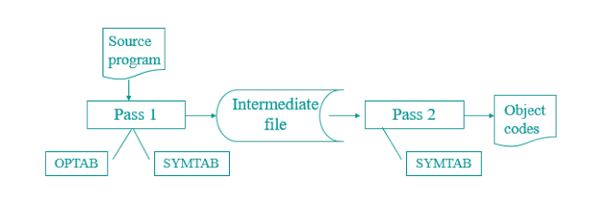
Design of 2 pass Assembler

Slide 8
Design of 2 – Pass Assembler
PASS 1:
Separate the Symbol, Mnemonic opcode, and operand fields
Build the symbol table
Perform LC Processing
Construct Intermediate Representation
PASS 2:
SYNTHESIZE THE TARGET PROGRAM
Advanced Assembler Directives
ORIGIN
EQU

Slide 9
Design of 2 – Pass Assembler
EQUSyntax: <Symbol> EQU <Address Specification>E.g. MAXLEN EQU 4096 Pass I of Assembler
Pass I Use following Data Structures
OPTAB
SYMTAB
LITTAB
POOLTAB

Slide 10
Design of 2 – Pass Assembler
2-pass system is to address the problem of forwarding references — references to variables or subroutines that have not yet been encountered when parsing the source code. A strict 1-pass scanner cannot assemble source code which contains forward references. Pass 1 of the assembler scans the source, determining the size and address of all data and instructions; then pass 2 scans the source again, outputting the binary object code.

Slide 11
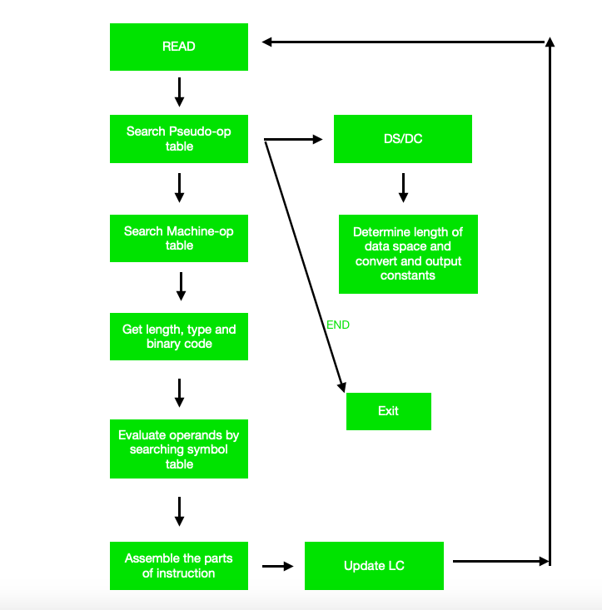
Design of 2 – Pass Assembler

Slide 12
Working of Pass-2
Pass-2 of assembler generates machine code by converting symbolic machine-opcodes into their respective bit configuration(machine understandable form). It stores all machine-opcodes in MOT table (op-code table) with symbolic code, their length and their bit configuration. It will also process pseudo-ops and will store them in POT table(pseudo-op table).
Various Data bases required by pass-2:
1. MOT table(machine opcode table)
2. POT table(pseudo opcode table)
3. Base table(storing value of base register)
4. LC ( location counter) Take a look at flowchart to understand:

Slide 13
References
Department of computer Science
[PDF] Systems Programming and Operating Systems by Dhamdhere - Free Download PDF (dlscrib.com)
[PDF] Principles of Compiler Design By Alfred V. Aho & J.D.Ullman Free Download – Learnengineering.in

Slide 14
THANK YOU

